Slide 1
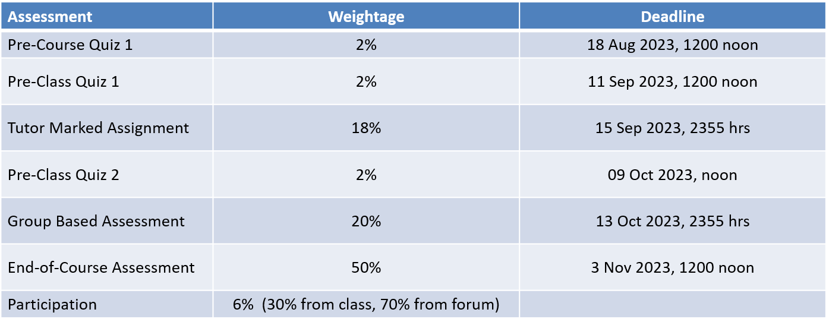
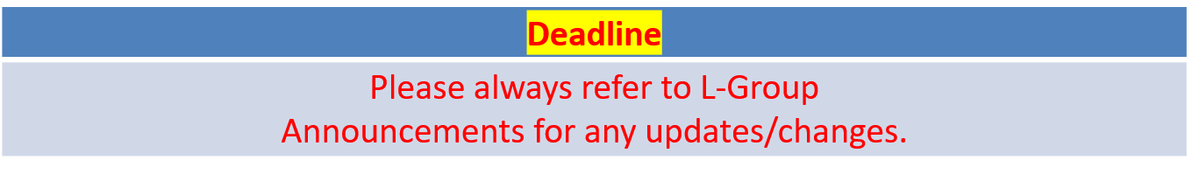
ANL252 – Assessments, weightage, deadlines
Time frame and Deliverables

Slide 2
Python for Data Analytics ANL 252
Faculty: Dr. Munish Kumar
Session 5: Data Analytics in Python

Slide 3
Learning Objectives of ANL201
By the end of this Session
Design Python programmes for performing data analytics
Analyse data using appropriate tools for data mining

Slide 4
Study Unit 5 Data Analytics in Python

Slide 5
Introduction to Scikit-Learn

Slide 6
Scikit-Learn
It is common to use Python to carry out tasks for data analytics, statistical modelling or machine learning recently.
One of the most common libraries used for these purposes is scikit-learn, a free machine learning library written for Python.
Scikit-learn features various algorithms such as classification, regression, clustering, etc.
In machine learning, programs are constructed with parameters such that they can “learn” from newly fed data.
Programs can automatically adjust and improve their behaviour according to the new “knowledge”.
Notes:
It has become very common to use Python to carry out tasks for data analytics, statistical modelling or machine learning recently. And the trend is rising.
In fact, many Python packages in these areas have also been developed. One of the most common libraries used for these purposes is scikit-learn, a free machine learning library written for Python.
One reason that scikit-learn has become one of the most common machine learning libraries for programming is its broad applicability and functionality.
It features various algorithms for classification, regression, clustering, etc.
In machine learning, programs are constructed with parameters such that they can “learn” from newly fed data. That is, they can automatically adjust and improve their behaviour according to the new “knowledge”.

Slide 7
Algorithms in Scikit-Learn
Here are some common algorithms available in scikit-learn:
Supervised learning
Linear Models | Gaussian Processes
Discriminant Analysis | Cross decomposition
Kernel ridge regression | Decision Trees
Support Vector Machines | Isotonic regression
Nearest Neighbours | Neural network models (supervised)
Unsupervised learning
Gaussian mixture models | Novelty and Outlier Detection
Clustering | Density Estimation
Covariance estimation | Neural network models (unsupervised)
Notes:
Here is a table of some common algorithms that are available in scikit-learn.
Beside machine learning algorithms, scikit-learn also provides modules for model selection, visualisation, data transformation as well as example datasets.

Slide 8
Install and Import Scikit-Learn
Use the import syntax to load scikit-learn into the program.
It is sklearn and not scikit-learn that refers to the scikit-learn library.
import sklearn
Notes:
Same as NumPy, matplotlib and pandas, we can simply use pip, the package installer of Python, to download and install scikit-learn.
After installing scikit-learn using pip, we can import it into our program.
Note that it is sklearn and not scikit-learn that refers to the scikit-learn library in the Python programs.

Slide 9
Import Algorithms from Scikit-Learn
Since the library is extensive, programmers usually only load the required algorithm or only its “estimator” object.
For instance, if linear regression models are required, import the estimator LinearRegression from the module linear_model by:
It is not unusual to load multiple algorithms for one analytics task.
Put sufficient comments in the program to explain the purpose and use of each imported module.
from sklearn.linear_model import LinearRegression
Notes:
Since the library is extraordinary extensive, programmers usually do not import the entire library.
Instead, the common practice is to load the required algorithm or only its “estimator” object.
For instance, if linear regression models are required for the analytics task, we can import the estimator LinearRegression from the module linear_model.
Since each module has its own estimators, functions, etc., it is important to refer to the official websites for the correct spelling, including the cases of the names.
It is not unusual that we need to load couple of them for a single analytics task. It is therefore important to put sufficient comments in the program to explain the purpose and use of each imported module.
But before we can apply any analytics algorithm, we need to prepare the data according to the requirements of each of the algorithms.

Slide 10
Activity
Import the following algorithms of scikit-learn into your JupyterLab notebook:
train_test_split
metrics
pre-processing
tree
Module “KMeans” from “cluster”
Module “PCA” from “decomposition”

Slide 11
Discussion
What is the difference between supervised and unsupervised machine learning?
The main difference between supervised vs unsupervised learning is the need for labelled training data.
Supervised: has a target; unsupervised: no target
Is it sensible to use alias when importing a module or an estimator of an algorithm from the scikit-learn package?
Yes

Slide 12
Data Preparation for Analytics Algorithms

Slide 13
Specify and Remove Missing Values
We can define specific strings beside the white strings ("") as missing values during the import process of a DataFrame using read_csv().
One way to deal with missing values is to remove those rows with any missing value from the DataFrame completely. (rem: axis = 0 is for rows)
DataFrame_name = pd.read_csv("csv_file_name.csv", na_values = "na_string", na_filter = True/False)
DataFrame_name.dropna(axis = 0, how = "any"/"all")
Notes:
One of the first steps in data preparation is to check on and to deal with missing values in the dataset.
Previously, we have discussed how to specify, identify, and modify observations with missing values. To recall some details, we can define specific strings in the dataset as missing values during the reading process and, at the same time, we instruct Python to treat white strings as missing values if necessary.
After creating a pandas DataFrame, we have to decide on the appropriate measure to deal with the missing values in it.
One way to deal with them is to remove those rows with missing values in any of the columns completely from the DataFrame.

Slide 14
Replace Missing Values
Alternatively, we can choose to replace missing values of an entire DataFrame or a particular column by specific values.
Different variable types may require different treatments of missing values.
DataFrame_name.fillna(value = repl_value)
DataFrame_name["column_label"].fillna(value = repl_value)
Notes:
Another way to deal with missing values is to replace them by specific values. Here, we can choose to apply the replacement on missing values of the entire DataFrame or just a specific column.
The advantage of replacing the missing values in all columns is certainly the convenience in creating the corresponding code. Nevertheless, it is not unusual that a DataFrame contains various types of variables. In this case, replacing all missing values by a single value may not be desirable or even possible. The replacement values should be chosen according to the characteristics and requirements of each variable.

Slide 15
Reduce Number of Categories
Categorical variables may need to be treated in data analytics.
Usually, they are converted to dummy variables required by some algorithms.
Example: Weight of {Normal, Overweight, Obese} can become two dummy variables of Overweight with either 0 or 1; and Obese with either 0 or 1. Here, 0 means No, 1 means Yes.
Sometimes to reduce the number of categories to simplify the problem.
Example: Grade {Fail, Subpass, Pass} can become {Fail, Pass}
In Python, we can replace category labels by the .replace() method:
DataFrame_Name["column_label"].replace(to_replace, value)
Notes:
If a DataFrame contains categorical variables, they must be treated differently in comparison to scale or interval variables.
In data analytics, we usually convert them to dummy variables in the pre-processing stage.
Nevertheless, if the variable contains a large number of categories, the number of dummy variables will become large as well.
As a result, the analytics algorithm will have to handle a large number of variables and the required computational effort in the fitting process could be significant.
One possible solution here is to reduce the number of categories at the expense of information loss. It is therefore a task for data analysts to balance this trade-off carefully.
Basically, the process of category reduction is to put observations from similar categories into a new category. For instance, if the country names are categories of a categorical variable, we can group them by their continents, and if a categorical variable contains the models of a certain product, we can group them by their brands or their main features. The similarity of the categories is essential here for not losing too much information.
In terms of programming, all we need to do is to replace some category labels in a variable by the .replace() method of the pandas package.
The parameter to_replace can be a list or dictionary of category labels to be replaced by the list or dictionary of new labels that is assigned to the value parameter.

Slide 16
Discretisation
If a categorical variable has ordered numeric values as categories, we can discretise them into new bins by the cut() function.
The cut() function only includes the rightmost edge in each bin and not the leftmost one.
Put the highest value of each category in the list of x. Start the list with -1 in case 0 also belongs to the original categories, or 0 otherwise.
DF_Name["column"] = pd.cut(x = array, bins, labels)
Notes:
If a categorical variable has ordered numeric values as categories, we can discretise them into new bins by the cut() function of the pandas package.
For our purpose here to reduce the number of categories, it is sufficient to put the highest value of each category in the list assigned to bins.
When applying the cut() function, we have to be aware that it only includes the rightmost edge in each bin and not the leftmost one. Hence, the list for bins should start with 0, or -1 in case 0 is one of the numeric values of the original categories.

Slide 17
Select Variables
Some variables may not be relevant to the analysis
Example: Name is not useful for predicting Income
These variables should be removed from the DataFrame before applying the scikit-learn estimator.
Use the attributes .iloc() and .loc() to select the necessary columns.
Notes:
It is very common that a dataset contains variables that are not directly relevant to be included in the analytics algorithm.
Some of them could be redundant in their meaning; some of them are the original version of a transformed variable.
These variables should be removed from the DataFrame before using the data to run the scikit-learn estimator.
We have learned how to select rows and columns from the pandas DataFrame using index, Boolean masks, and localisation.
The attributes .iloc() and .loc() are crucial in this context. We can use the same procedures to select the necessary columns for the scikit-learn algorithm.

Slide 18
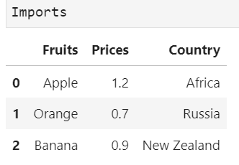
Using iloc vs loc for Selection (I)
Suppose we only need Fruits and Prices from Imports dataset

Slide 19
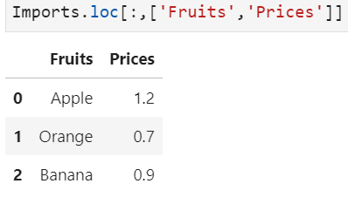
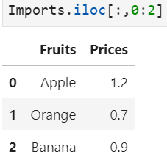
Using iloc vs loc for Selection (II)
loc: we specify the variable labels ‘Fruits’, ‘Prices’
iloc: we specify column indices 0:2 after the comma

Slide 20
Rename Variables
Use the .rename() method to rename the variables in a DataFrame.
The column labels to be renamed must be put as keys of a dictionary.
The values of the dictionary will be the new labels of the corresponding columns.
DF_Name["column"].rename(columns = {"oldvar": "newvar"})
Notes:
If a dataset is originated from an external source, the given variable names may not necessarily reflect the needs and ideas of the analyst.
Sometimes, they can be lengthy and make the result output visually appalling. In pandas, the .rename() method is used to rename the variables in a DataFrame.
The column labels to be renamed must be put as keys of a dictionary that will be assigned to the parameter columns in the .rename() method. The values of the dictionary will then be the new labels of the corresponding columns.

Slide 21
Create Dummy Variables
Categorical variables must be converted to dummy variables before included in the scikit-learn algorithms.
Dummy variables only have two values: 0 and 1.
If an observation belongs to a certain category, the corresponding dummy variable will be 1, otherwise 0.
Use get_dummies() to convert categorical variables to dummy variables.
Use .astype() to change a numeric categorical variable to “category”, “str” or “object” before converting it to dummy variables.
DF_name["column"] = pd.get_dummies(data, drop_first)
DF_name.astype({"var_name": "type_str", …})
Notes:
Categorical variables must be converted to dummy variables before they can be evaluated and included in the computation of the scikit-learn algorithms.
Dummy variables are binary variables that only have two values: 0 and 1.
If an observation belongs to a certain category, the corresponding dummy variable will be 1, otherwise 0.
Since each category of a categorical variable will be transformed to a dummy variable, the number of categories has indeed a direct impact on the number of dummy variables in the final DataFrame used in the algorithm.
As a result, it is important to keep the number of categories at a rather low level.
In Python, we can convert categorical variables to dummy variables using the get_dummies() function of the pandas package.
The parameter drop_first is used to instruct Python to take the first category as the reference level and remove it from the resulting DataFrame.
The reason to define a reference level for categorical variables and to remove it from the DataFrame is to avoid linear dependence in the data matrix, which causes error in the calculation.
The default setting here is drop_first = False. In this case, all dummy variables will remain in the resulting DataFrame.
Since most of the modules in scikit-learn have their own algorithms to deal with this issue, we can keep this setting without causing error in the estimation process.
The meaning of the parameter data is obvious. Note that pandas will create dummy variables for each uniquely existing string in all non-numeric variables.
If we have a numeric categorical variable which we would like to convert to dummy variables as well, we will need to change its data type using the .astype() method.
The value that should be given to the parameter dtype should be a string that indicates a valid Python data type such as int, float, category, str, object, bool, etc.
To create dummy variables for a numeric categorical variable, we can either change it to “category”, “str” or “object”.

Slide 22
Data Transformation
Variables with wide range of values tend to have higher impact in the model than those with smaller value ranges.
They need to be scaled down to match the other numeric variables.
The most common methods here are normalisation and standardisation.
For normalisation, use normalize() from the preprocessing module.
For standardisation, the estimator needs to be initiated first before the transformation can take place.
Object_name = sklearn.preprocessing.normalize(X)
scaler = preprocessing.StandardScaler()
scaler.fit(X)
Object_name = scaler.transform(X)
Notes:
Numeric input variables are generally easier to deal with. But they can also cause trouble in the model estimation.
For instance, the range of their values can be rather wide.
As a result, variables with such characteristic tend to have higher impact in the model than those with smaller value ranges.
Therefore, they need to be scaled down to match the value range of other numeric variables. The most common methods for this purpose are normalisation and standardisation.
In scikit-learn, the normalisation and standardisation functions can be found in the preprocessing module.
The normalize() function is actually straightforward and easy to handle. The object assigned to parameter X can be a DataFrame, a NumPy array, etc.
The syntax for standardisation requires the initialisation of the estimator first. The data can be then transformed in the subsequent step.
We first initiate scaler as the estimator object for StandardScaler from the preprocessing module.
Then, the mean and standard deviation of the object X, which should be a DataFrame, will be computed by the fit() function.
In the final step, the object X will be standardised by the transform() function.

Slide 23
Training and Testing Data
The performance of a predictive model is measured by its accuracy of predicting unseen data.
Since such data are usually unavailable, analysts usually “hold back” a subset of data, the testing dataset, for model evaluation purpose.
The remaining data, the training dataset, are used to construct the model.
The train_test_split() function from the model_selection module splits DataFrame randomly into training and testing datasets.
The default proportion of training and testing data in sklearn is 0.75:0.25.
Object_name = sklearn.model_selection. train_test_split(arrays, test_size, random_state)
Notes:
In data analytics, the performance of a predictive model is measured by its accuracy of predicting unseen data.
However, such data are usually unavailable. On the other hand, testing the prediction performance of a model by applying it on the original data based on which the model was constructed in the first place is not sensible at all.
Therefore, analysts usually “hold back” a subset of data, namely the testing dataset, for model evaluation purpose. The remaining data form the training dataset for the construction the model.
In Python, the module model_selection provides the train_test_split() function to draw observations randomly from the original DataFrame into the training and the testing datasets.
The objects assigned to the parameter arrays can be NumPy arrays, pandas DataFrames, etc.
A value between 0 and 1 should be given to the parameter test_size, which determines the proportion of observations in the original array that the testing dataset should be distributed to. The default value here is 0.25.
The parameter random_state controls the shuffling applied to the data before applying the split. The default value here is "None", which means that different random seeds will be selected independently every time the function is being executed. That is, different observations will be chosen for the testing dataset in every run. Consequently, the testing result of the model will be different as well.

Slide 24
Extract Dependent and Independent Variables (I)
In scikit-learn, the ultimate command of many algorithms is to fit a model by the .fit() function which has two parameters: X and Y.
The parameter X is the design matrix containing all independent variables.
The parameter Y is the vector of the target variable.
Both X and Y can be NumPy arrays or pandas DataFrames.
We need to extract X and Y from the original DataFrame.
Notes:
In scikit-learn, the ultimate command of many algorithms to fit a model on a DataFrame is the .fit() function.
The .fit() function has usually two parameters: X and Y, where Y could be optional for some algorithms.
The parameter X is the design matrix that contains all independent variables, and Y is the vector of the target variable.
Both X and Y can be NumPy arrays or pandas DataFrames.
As a result, we need to extract the independent variables as a matrix and the dependent variable as a vector from the original DataFrame.

Slide 25
Extract Dependent and Independent Variables (II)
Select the column representing Y and save it as a new object.
Subset the matrix of X from the DataFrame in similar manner.
If the DataFrame only contains the independent and target variables, just drop the target variable from the original DataFrame to obtain X.
y = DataFrame_name["target_var"]
X = DataFrame_name[["X1", "X2", …]]
X = DataFrame_name.drop("target_var")
Notes:
The procedure here is rather straightforward. We simply select the column that represents our dependent variable and save it as a new object.
Similarly, the matrix of the independent variables can be selected in the same manner.
Note that it is required to wrap the names of the independent variables in a list (square brackets) first before putting them in the index operator [].
If the DataFrame only contains the independent variables and the target variable, we can also simply drop the target variable from the original DataFrame to obtain X.
If the target variable is categorical and has been transformed to various dummy variables, the names of the dummy variables must be put in a list when passing them to the .drop() method.

Slide 26
Other Data Preparation techniques
Purpose | Common treatment | Comment
Treat missing values | Remove the records with missing values; replace the missing values | Please refer to SU4 for more details.
Treat outliers | Remove the outliers | Please refer to SU4 for more details.

Slide 27
Other Data Preparation techniques (Cont’d)
Purpose | Common treatment | Comment
Treat categorical values | Create dummy variables, one-hot encoding | Need to be treated in algorithms that can only process numerical variables. For example, age categories of {infant, young, adult, elderly} are converted into three dummy variables. Young = {0, 1}, Adult = {0, 1}, Elderly = {0, 1}. And when these three variables are all zeros, it implies Infant.
Treat numerical values | Discretisation or binning | To convert one numeric variable (e.g., age) to categorical values of {infant, young, adult, elderly}

Slide 28
Other Data Preparation techniques (Cont’d)
Purpose | Common treatment | Comment
Normalisation/standardisation | Scaling/transforming variables | Convert data into a standard scale for easy comparison and interpretation. Useful when the data has different units of measurement or scales.

Slide 29
Activity
Car sales program:
Carry out the following tasks in JupyterLab:
Since there are many car models (especially their names are complicated and not comparable with each other) in the market, it is rather more important to include “category” than “model” in our analysis later.
Remove “model” from the DataFrame.
Reduce the categories in “category” by assigning each car to a SOLE category if it has more than one in the original dataset such as “Convertible, Coupe” or “Coupe, Convertible”.
Create a training and a testing dataset. The proportion here should be 0.7:0.3 and the random state should be set to 0.

Slide 30
Discussion
Can we use the .replace() method to reduce the number of categories of a numeric categorical variable instead of discretisation?
If the target variable is categorical and binary, there must be two dummy variables resulting from the dummy-variable-conversion. Which dummy variable shall we choose for the scikit-learn algorithm?

Slide 31
Discussion (Answers)
Can we use the .replace() method to reduce the number of categories of a numeric categorical variable instead of discretisation?
replace can be used for a numeric categorical variable
If the target variable is categorical and binary, there must be two dummy variables resulting from the dummy-variable-conversion. Which dummy variable shall we choose for the scikit-learn algorithm?
Depends on the goal of your algorithm
Which target do you want to predict?

Slide 32
Activity
SU5 Regression Example
Run through the SU5 linear regression notebook

Slide 33
15 min break

Slide 34
Clustering

Slide 35
Introduction to K-Means Clustering
One of the most popular clustering algorithms is the K-Means method.
This technique is very efficient in clustering large data sets.
The algorithm here is to split the data into K groups with equal variance by minimising the variation within the cluster (inertia).
The K-Means method requires the number of clusters to be specified before the algorithm starts.
The clusters are characterised by their centroids (means), the centre of an area in a two-dimensional space.
The K different means should be explored during the clustering process.
Notes:
Clustering is a multivariate technique to group “similar” observations into disjoint, finite number of clusters.
One of the most popular clustering algorithms is the K-Means method. This technique is very efficient in clustering large data sets.
The algorithm here is to split the data into K groups with equal variance by minimising the variation within the cluster.
This variation is called the inertia or within-cluster sum-of-squares.
In other words, “members” in the same cluster should be as “similar” as possible, while observations from different clusters should be most distinguishable.
Different from some other clustering algorithms in which the number of clusters will only emerge during the grouping process, the K-Means method requires the number of clusters to be specified before the algorithm starts.
The clusters are characterised by their centroids, which can be interpreted as the centre of an area in a two-dimensional space, and therefore, they are the average of all the observations within a cluster.
As the name of the algorithm suggests, there should be K different means (centroids) and they should be explored during the clustering process.

Slide 36
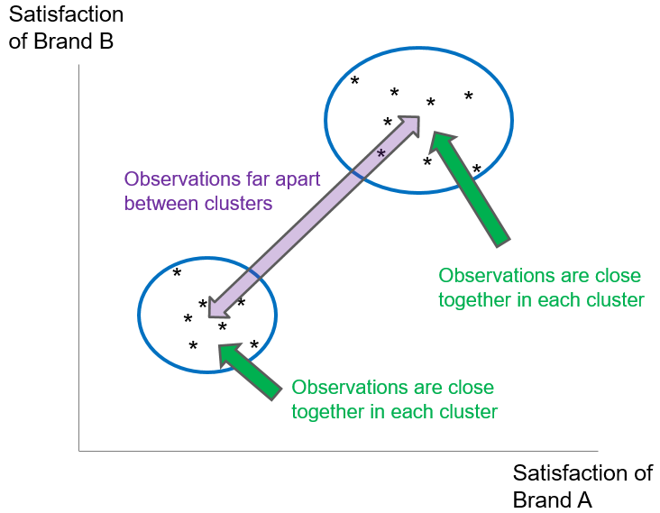
Intuition of K-Means Clustering
We want members in a cluster to be ‘close’ to each other, and clusters to be far apart from each other.

Slide 37
K-Means Clustering Process
The process of K-Means clustering contains five main steps:
Select K observations randomly as initial cluster centroids.
Compute the distance of each object to the centroid.
Assign each object to the nearest centroid based on the distance computed. Objects assigned to the same centroid form a cluster.
Recompute the centroid for each cluster using the objects in it. Restart iteration from Step 2.
Iteration stops when the centroids remain unchanged, or a specified number of iterations has been performed.
Notes:
The process of K-Means clustering can be described in five main steps:
K observations are randomly selected as initial cluster centroids where K is a pre-defined positive integer.
Compute the distance of each object to the centroid.
Based on the distance computed, each object is assigned to the nearest centroid. Objects assigned to the same centroid then form a cluster. There will be K number of clusters.
For each cluster, recompute the centroid using the objects assigned to the cluster. The iteration starts again from Step 2.
The iteration stops when the centroids remain unchanged or a specified number of iterations has been performed.

Slide 38
K-Means Properties
The Euclidean distance is preferred in general when computing the distance between an object to the centroids.
The Euclidean distance is measured by the sum of the squared differences between the values of some selected clustering criteria.
After the clustering process, ensure the insights created by the resulting clusters. A good clustering solution allows clear description of the cluster profile.
Evaluate the quality of clustering solutions by cohesion, separation and parsimony.
Notes:
Note that the distance refers to the Euclidean distance in general.
The Euclidean distance between an object and a cluster centroid is measured by the sum of the squared differences between the values of some selected clustering criteria, which are usually some input variables of the object and the values of the same clustering criteria of the centroid.
Subsequent to the clustering process, it is important to make sure that the resulting clusters really create some insights.
To interpret the clusters, the characteristics of each cluster should be explored by looking at the summary statistics (e.g. mean, min, max) of the clustering criteria.
A good clustering solution should allow us to describe the profile of each cluster clearly.
In addition, there are objective measures for evaluating the quality of clustering solutions: cohesion, separation and parsimony.
The cohesion measures the similarity of the objects in a cluster. This value should be small because these objects should be similar.
The separation, on the other hand, measures how dissimilar the clusters are, and this value should be high.
Here, we can apply the Silhouette coefficient since it combines both the cohesion and the separation.
Briefly speaking, the Silhouette coefficient is a value between -1 and 1 that measures the relationship between the intra-cluster distances and nearest cluster distances.
The mean of the individual Silhouette coefficients will be computed for every clustering solution for evaluation.
A high and positive average Silhouette coefficient suggests appropriate and useful cluster solution.
On the contrary, negative Silhouette coefficient indicates a rather undesirable clustering result.
Furthermore, parsimony is another important criterion in clustering.
As a result, we prefer smaller number of clusters if the quality of the corresponding clustering solution is satisfactory.
Nevertheless, the number of clustering criteria should also be parsimonious, so that the clustering solution can be interpreted conveniently.

Slide 39
Fitting K-Means Clustering by Scikit-Learn
In scikit-learn, all algorithms are controlled and executed by the estimator.
Adjust the parameters for the modelling process in the syntax of the estimator declaration.
In K-Means Clustering, the estimator is called KMeans. And it can be imported from the cluster module of the scikit-learn package.
Initiate the KMeans estimator first and adjust the estimation parameters according to the individual needs.
from sklearn.cluster import KMeans
km_Object = sklearn.cluster.KMeans(n_clusters = 8, init = "k-means++", n_init = 10, max_iter = 300, tol = 0.0001, precompute_distances = "auto", random_state = None)
Notes:
In scikit-learn, all algorithms are controlled and executed by the so-called estimator. We can adjust our parameters for the modelling process in the syntax of the estimator declaration.
In K-Means Clustering, the estimator is called KMeans. And it can be imported from the cluster module of the scikit-learn package.
First, we need to initiate the KMeans estimator and adjust the estimation parameters according to our needs.

Slide 40
Parameters of the K-Means Estimator
Below is a list of the parameters of the K-Means estimator.
(Source: https://scikit-learn.org/stable/modules/generated/sklearn.cluster.KMeans. ‌html)
Parameter | Value Type
n_clusters (Default: 8) | Integer
init (Default : "k-means++") | "k-means++", "random", callable, array-like of shape
n_init (Default: 10) | Integer
max_iter (Default: 300) | Integer
tol (Default: 1e-4) | Float
precompute_distances (Default: "auto") | "auto", True, False
random_state (Default: None) | Integer, RandomState instance, None
Notes:
Hiere is a list of parameters of the K-Means estimator.
n_clusters is the number of clusters to form as well as the number of centroids to generate.
init is the method for initialisation:
"k-means++": selects initial cluster centres for k-mean clustering in a smart way to speed up convergence.
"random": choose n_clusters observations at random from the data as initial centroids.
Array: An array with number of rows equal to the number of clusters, and number of columns equal to the number of variables that give the initial centroids.
Callable: Any function or method that takes arguments X, number of clusters and a random state and return an initialisation.
n_init is the number of time the k-means algorithm will be run with different centroid seeds. The final results will be the best output of n_init consecutive runs in terms of inertia.
max_iter is the maximum iterations of the k-means algorithm for a single run.
tol is the relative tolerance of the difference in the cluster centres of two consecutive iterations to declare convergence.
precompute_distances takes three possible values:
"auto": do not precompute distances if n_samples * n_clusters > 12 million. This corresponds to about 100MB overhead per job using double precision.
True: always precompute distances.
False: never precompute distances.
random_state determines the random number generation for centroid initialisation. Use an integer to make the randomness deterministic.

Slide 41
Fit K-Means Clustering
Perform K-Means clustering using the KMeans estimator.
X is a prepared DataFrame based on which the clusters are constructed.
With sample_weight we can pre-specify the weights for each observation in X. If it is set to None, all observations will be assigned equal weight.
The fitted estimator of the K-Means algorithm is saved in km_fit_Object.
km_fit_Object = km_Object.fit(X, sample_weight = None)
Notes:
We can attach fit() to the KMeans estimator object to perform K-Means clustering on a prepared DataFrame.
The parameter X is a prepared DataFrame based on which the clusters are constructed.
With sample_weight, we can pre-specify the weights for each observation in X. If it is set to None, which is also the default here, all observations will be assigned equal weight.
The fitted estimator of the K-Means algorithm is saved in the object left to the equal sign.

Slide 42
Predict K-Means Clustering
Predict the cluster classification for each observation in the original DataFrame using the fit_predict() function.
X contains the data for which the cluster prediction is calculated.
The output object here is an array with indices of the clusters to which each sample is assigned.
Use elbow method to determine the optimal number of clusters before the clustering algorithm starts.
km_pred_Object = km_Object.fit_predict (X, sample_weight = None)
Notes:
To obtain and view the results of the estimation, we still need to request scikit-learn to predict the cluster classification for each observation in the DataFrame X.
The parameters here are the same as the .fit() function.
The parameter X contains the data for which the cluster prediction will be calculated.
The pre-specified individual weights in sample_weight will be assigned to all observations in the dataset.
The output object here is an n-dimensional array of length n_samples, i.e., the number of observations in the dataset.
The items in the array are indices of the cluster that each sample belongs to.
Recall that the number of clusters, K, must be specified before the clustering algorithm starts. One way to determine the optimal value of K is the elbow method.
Elbow method is a popular technique that uses the inertia as the measurement to compare the distortions in some clustering solutions with different K.
The distortion is the sum of squared distances of each data point to the centroids. The plot of distortions which looks like an arm will then be generated.
The best value of K can be found at the “elbow”, the inflection point on the curve.
To determine the inertia of a clustering solution, we can apply the .inertia_ method on a KMeans estimator.

Slide 43
Obtain the Clusters
To obtain and view the clusters of each data point, we can use the following syntax:
X contains the data for which the cluster prediction is calculated.
Print(km_fit_Object.labels_)

Slide 44
Explore K-Means Clustering Models (I)
Explore the characteristics of the clusters by looking at some statistics such as mean, min, max, etc. of the clustering criteria.
Cross-tabulate the clustering criteria and the cluster index to understand the features of the clusters.
If a clustering criteria variable is categorical, interpret the clusters based on the proportional distribution of the clusters in each category.
Create cross-tables with the crosstab() function:
Clustering criteria are usually listed in rows rather than in columns.
Cluster indices are placed as columns since the cluster number is limited.
pd.crosstab(index = criteria_var, columns = cluster_index, normalize = "index", margin = True)
Notes:
The characteristics of the clusters can be examined by looking at some statistics such as mean, min, max, etc. of the clustering criteria based on which the clusters have been constructed.
For this purpose, we can cross-tabulate the clustering criteria and the cluster index to understand the features of the clusters.
If a clustering criterion variable is categorical, our focus of interpretation will be on the proportional distribution of the clusters in each category.
With the crosstab() function, we can easily create a cross-table to fulfil our purpose.
The object assigned to the first parameter of the crosstab() function is the row variable of the cross-tabulation.
In most of the cases, one of the clustering criteria is placed here since the number of categories could be rather large, and it is more convenient to have them listed in rows rather than in columns.
If multiple names are passed to this parameter, these variables will be tabulated in hierarchy.
The second parameter controls the column variable. Our suggestion is to place the cluster index here since the number of clusters is usually limited.
The parameter normalize can take the values "all", "index", "columns", {0, 1}, or {True, False} where the default value is False, or 0 equivalently.
If normalize = True or 1, Python will return the table percentage of each cell, while the counts of each cell will be shown if normalize is False or 0.
If normalize = "index", the row proportion of the cell will be calculated, while the column percentage will be provided if normalize = "column".
If margin = True, the marginal frequency of the axis specified in the normalize parameter will be listed out as well.

Slide 45
Activity
Run through the SU5 Clustering Notebook

Slide 46
Explore K-Means Clustering Models (II)
The crosstab() function is not suitable for numeric clustering criteria.
Let Python calculate certain statistics of the clustering criteria for each cluster.
Use the .groupby() method to group the data into clusters.
The result is grouped by the cluster indices.
The method to compute the statistics of interest is appended to it.
We can transpose the result since it is more common to have the cluster index, the grouping variable in .groupby(), displayed in the columns.
DF[[criteria_var, cluster_index]] .groupby(by = [cluster_index]).anymethod().transpose()
Notes:
If a clustering criterion variable was numeric, the crosstab() function would not be a good choice since it would take every unique value in it as a separate category.
In this case, we would rather let Python calculate some statistics of the clustering criteria for each cluster.
And the .groupby() method of the pandas package would become applicable in our Python program once again.
The syntax here is specifically adjusted for clustering interpretation.
First, we merge the selected clustering criteria variables from the original DataFrame with the cluster classification variable.
The resulting DataFrame will be grouped by the cluster indices, and the method to compute the statistics of interest is appended to it.
Note that the variable used in the .groupby() method, which is the cluster index in this case, will be displayed as rows.
Therefore, we may transpose the DataFrame resulted from the .groupby() method to swap the rows and columns.
After transposing the table, the cluster indices are put as columns in the same way crosstab() does.
But it is more a step to standardise the presentation rather than an analytics requirement and hence optional for us to integrate it in our syntax or not.

Slide 47
Evaluate K-Means Clustering Models
Use Silhouette coefficient to evaluate the cohesion and separation of a clustering solution.
In scikit-learn, we can use silhouette_score() from the metrics module to calculate it.
metrics.silhouette_score(criteria_var, cluster_index)
Notes:
The Silhouette coefficient is used to evaluate the cohesion and separation of a clustering solution.
In scikit-learn, we can apply the silhouette_score function from the metrics module to calculate it.
The first parameter of the function refers to the matrix of the input variables, or clustering criteria.
The second parameter requests for the array of the fitted cluster of each observation.

Slide 48
Plot K-Means Clusters
Plot all data points with their cluster classification in a two-dimensional scatter plot to visualise a clustering solution.
If we have more than two clustering criteria, we need to reduce the dimensionality of all the input variables down to two before plotting.
One common methods here is the Principal Component Analysis (PCA).
PCA() is an estimator from the decomposition module.
Use the .fit_transformation() to obtain an array with the coordinates of each observation in the two-dimensional space.
pca_Object = sklearn.decomposition.PCA(n_components)
pca_fit_Object = sklearn.decomposition. fit_transform(criteria_var)
Notes:
Another possibility to understand a clustering solution is the graphical approach.
The idea of this approach is to plot all the data points with their cluster classification in a two-dimensional scatter plot.
This approach would be rather straightforward if only one or two input variables have been used as clustering criteria.
In the multivariate case, we need to reduce the dimensionality of all the input variables down to two before plotting.
One of the most common methods to reduce the dimensions of a high-dimensional array (or matrix) is the Principal Component Analysis (PCA).
The idea of the PCA is to project each data point onto the first few principal components which contain the majority of the variation in the data.
The loss of information caused by the omission of the remaining components is then insignificant and the data dimension is reduced to the number of principal components.
In our case, we may only be interested in the first two components to span the space for our scatter plot.
Note that PCA() is an estimator from the decomposition module. Here, we can specify the number of components we would like the result to contain.
Subsequently, we need to use the .fit_transformation() (not the .fit() function here) since we are interested in the transformed values of all the criteria variables. The criteria variables are therefore the input variables here.
The returned object here is an n-dimensional NumPy array with the transformed data.
Hence, the array has 2 columns, and its number of rows corresponds to the number of observations in the DataFrame that has been passed to the .fit_transformation() function in the first place.

Slide 49
Activity
Car sales program:
Carry out the following tasks in JupyterLab using the prepared DataFrame from the previous chapter:
Conduct an elbow-test and determine the optimal number of clusters.
Construct a K-Means clustering solution with the number of clusters obtained from the previous task.
Explore the estimated clustering solution by cross-tabulating the cluster index with the clustering criteria.
Plot the clustering solution as a 2-dimensional scatter plot.

Slide 50
Discussion
What are the steps in a K-Means clustering process? How are these steps reflected in the parameters of the KMeans estimator?
What kind of information are stored in the object resulting from the fit() function?

Slide 51
15 min break

Slide 52
Decision Trees

Slide 53
Introduction to Decision Trees (I)
Decision trees split a sample to reach certain decision points based on some criteria. It is therefore a sample classification technique.
Each decision point is called a node and represents a subset of the sample.
Nodes split from a superordinate node are called the child node while the origin node is called the parent node.
A child node with no further subdivisions or splitting is called a leaf node.
The decision tree algorithm predicts the individual classification based on the input variables and the value of the target variable at the same time.
These rules of decision form the resulting model which can be illustrated by a tree-like structure graphically.
Notes:
Decision trees are among the most common data mining methods which are applied to split a set (or subset) of observations to reach certain decision points based on some criteria eventually.
Each decision point in the tree is also called a node and represents a subset of the sample based on which the decision tree is created.
Nodes split from a superordinate node are called the child node while the origin node is called the parent node. A child node with no further subdivisions or splitting is called a leaf node.
Since each observation in the sample will be assigned to one of the nodes eventually, decision tree is a classification technique to separate a sample into multiple classes.
The decision tree algorithm predicts the individual classification based on the values of some input variables and calculates the predicted value of the target variable at the same time.
These decision rules form the resulting model which can then be illustrated by a tree-like structure graphically. This structure convenes the interpretation of the modelling result.

Slide 54
Introduction to Decision Trees (II)
Decision tree model illustrates the complex relationship between the target variable and the input variables rather well.
The importance of the input variables in the decision rules is reflected in the decision tree. Higher up variables are more important.
The value of a leaf node is the prediction of the target variable for those observations classified in it.
If the target variable is categorical, the predicted value will be the mode. If it is numeric, the value will be the mean.
Notes:
We can also use the decision tree model to understand the relationship between the target variable and the input variables.
In fact, decision tree handles complex relationship such as non-linearity and interaction rather well.
Note that not all input variables are of the same importance in the classification process. Their hierarchy in the decision rules reflects in the decision tree in which input variables appear higher up are more important.
Nodes without further splitting are called the leaf nodes. Their value is the prediction of the target variable for those observations classified in the corresponding nodes.
If the target variable is categorical, the value of the leaf node will be the mode, the most frequent class.
And it will be the mean of the data in that node if the decision tree is predicting a numeric variable.

Slide 55
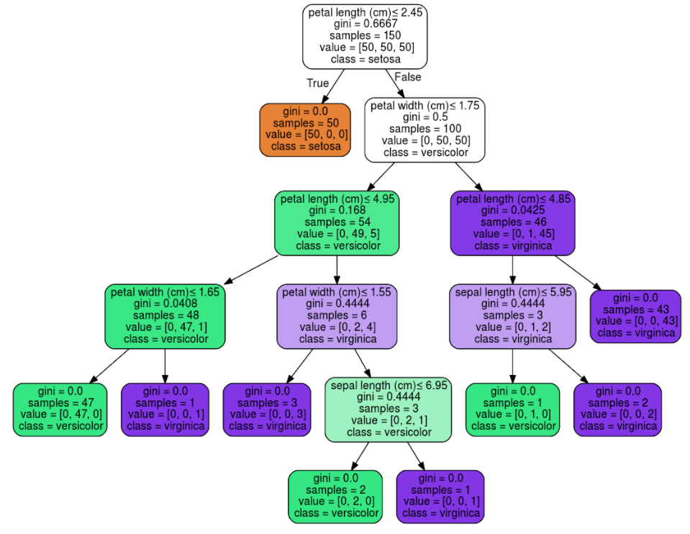
Example of Decision Tree
Source: https://scikit-learn.org/stable/modules/tree.html
Root node; the most important feature
In total, we have 9 leaf nodes (nodes in the red rectangles)

Slide 56
Algorithm of Constructing Decision Trees (I)
The most common algorithms for constructing decision trees are CHAID (chi-square automatic interaction detection), C5.0 (a proprietary algorithm) and CART (classification and regression tree).
The estimators DecisionTreeClassifier and DecisionTree-Regressor of scikit-learn use an optimised version of CART.
The CART algorithm can create classification and regression trees.
Regression trees estimate values of continuous target variables, while classification trees predict outcomes of categorical target variables.
CART splits the tree into two sub-samples at every decision point based on the input variables.
The splitting process terminates once certain stopping criteria are fulfilled.
Notes:
Over the years, there have been many algorithms for splitting the nodes and hence the construction of the tree developed, proposed, and implemented in software packages.
The most common ones are CHAID (chi-square automatic interaction detection), C5.0 (a proprietary algorithm) and CART (classification and regression tree).
In Python, the estimator DecisionTreeClassifier of the scikit-learn package uses an optimised version of the CART algorithm.
As the name suggests, the CART algorithm is capable to create both classification trees and regression trees. While regression trees estimate the values of a continuous target variable, classification trees predict the outcome of a categorical target variable. In other words, CART is applicable on almost every type of output variables.
In CART, every parent node has only two child nodes. That is, CART will only split the tree into two sub-samples at every decision point.
And the calculation of the split is based on the input variables that are also used to predict the target output. The splitting process terminates once certain stopping criteria are fulfilled.

Slide 57
Algorithm of Constructing Decision Trees (II)
The sample subset at each node become more homogeneous as the split proves advances.
The homogeneity of each subset reflects the split quality from a parent node to its child nodes.
In classification tree, the homogeneity is measured by Gini and Entropy.
In regression tree, the impurity is measured by the sum of squared error (SSE).
In both options, the split with the highest reduction of impurity or highest homogeneity in the child nodes will be chosen.
Notes:
As the split process advances, the sample will be divided into more and more, smaller and smaller subsets. These subsets will also become more and more homogeneous. The whole splitting process will be terminated once certain stopping criteria are fulfilled.
The homogeneity of each subset reflects the split quality from a parent node to its child nodes.
In classification tree, the homogeneity is measured by Gini and Entropy. Roughly speaking, both Gini and Entropy measure the impurity of a node, but with different theoretical background. By comparing the impurity decrease across all possible splits in all input variables, the split with the highest reduction of impurity will be chosen.
In scikit-learn, both Gini and entropy are options of the criterion parameter in the DecisionTreeClassifier.
In regression tree, the impurity is measured by the sum of squared error (SSE). The SSE is the total deviance of each observation from the sample mean. For each potential split, CART computes the SSE for each child node and the split with the lowest total SSE across all child nodes will be chosen. Since the mean of the target variable of the leaf node is equal to the predicted value of the target variable, splits with low SSE have child nodes that contain data whose target values are close to the mean value.

Slide 58
Algorithm of Constructing Decision Trees (III)
Two possibilities to stop the CART algorithm:
no or little improvement of impurity detected after a new split
Gini/SSE drops below a threshold
Low Gini or SSE indicates rather homogeneous nodes, another split would not decrease the impurity significantly.
High thresholds: oversimplified trees. Low thresholds: overcomplicated trees.
a pre-specified depth (number of splits) of the tree is reached
control tree size without oversimplifying or overcomplicating it.
Set a lower bound of observations in the nodes.
Notes:
One possibility to stop the CART algorithm is when the impurity improvement of a new split drops below a certain pre-defined threshold.
For instance, if a node has reached a rather low Gini or SSE respectively, meaning that the parent node itself is already rather homogeneous, another split from the node would only create homogeneous child nodes.
In this case, this split is not really necessary since it does not decrease the impurity significantly.
Nevertheless, choosing the right thresholds to stop the split algorithm is not as straightforward as it seems.
If the thresholds are high, the resulting tree could be oversimplified as splits become more difficult. Low thresholds, on the other hand, could lead to overcomplicated trees that are difficult to interpret and deploy.
Another possibility to stop the algorithm is when the tree has attained a pre-specified depth. The depth of the tree refers to the number of splits in it.
This method can simply control the size of the tree without oversimplifying or overcomplicating it.
One last stop criterion is to set a lower bound of observations in the nodes. Once the number of observations in all nodes has reached the bound, a new split from any node would only create child nodes that contain less observations than the lower bound allows.
As a result, the lower bound blocks the algorithm from carrying out another split and the entire process ends.

Slide 59
Evaluation of Decision Trees (I)
Evaluate the performance of a decision tree by examining its fit on available data.
For classification trees, use confusion matrix
Summarise correct and incorrect classifications.
The larger the proportion of identical predicted and observed classifications, the more accurate is the decision tree model.
For regression trees, use Root-Mean-Square-Error (RMSE)
Average deviance of all predicted values from the observed values.
The lower the deviance, the closer are the predictions to the actual values, and the better is the model.
Notes:
One way to evaluate the performance of a decision tree is to examine the precision of its prediction.
In other word, the predicted values of the target variable will be compared with the observed data.
For classification trees, we can use the confusion matrix in which the correct and incorrect classifications are summarised.
The larger the proportion of observations for which the predicted and observed classifications are identical, the more accurate is the decision tree model.
For regression trees, the Root-Mean-Square-Error (RMSE) is usually used to measure the prediction accuracy of the model.
Basically, the RMSE is kind of an average deviance of all the predicted values from their observed counterparts.
The lower such deviance is, the closer are the predictions to the actual values, and the better is the model.

Slide 60
Evaluation of Decision Trees (II)
Evaluate also the performance of a decision tree by its prediction accuracy on unseen data.
Partition the original dataset randomly into a training and a testing dataset.
The decision tree as a predictive model is evaluated by its ability to apply what it has “learned” from the training data to the testing data.
If the prediction accuracy of the model on the training data is much higher than the testing data, the model tends to be overfitted.
Notes:
Furthermore, the performance of a decision tree on unseen data must be evaluated as well.
For this purpose, we partition the original dataset randomly into a training and a testing dataset.
The training dataset is used to construct the model while the predictive performance of the model will be evaluated based on the testing dataset.
In other words, the decision tree as a predictive model is evaluated by its ability to apply what it has “learned” from the training data on the testing data.
If the prediction accuracy of the model on the training data is much higher than the testing data, the model tends to be overfitted.
It is too specialised to the structure of the training dataset and not generalised enough for other data that do not contain certain unique characteristics of the training data.

Slide 61
Decision Tree Estimators (I)
Import the sklearn.tree module in the first place.
Initiate the DecisionTreeClassifier estimator for classification tree:
To fit a regression tree, declare the DecisionTreeRegressor estimator.
“…” indicates the parameters of the estimator that control the fitting of the decision trees.
from sklearn import tree
tree_Object = sklearn.tree.DecisionTreeClassifier(…)
tree_Object = sklearn.tree.DecisionTreeRegressor(…)
Notes:
Same as K-Means clustering, scikit-learn also has an estimator for decision trees model which is integrated in the tree module.
In order to be able to use all possible functions in the module, the sklearn.tree module shall be imported in the first place.
If we want to apply a classification tree in Python, we have to initiate a DecisionTreeClassifier estimator object whereas if the data should be fitted by a regression tree, a DecisionTreeRegressor estimator object should be declared.

Slide 62
Decision Tree Estimators (II)
Here is a list of the parameters of the DecisionTreeClassifier and DecisionTreeRegressor estimators.
The main differences between them are the parameter criterion and the availability of the parameter class_weight.
(Source: https://scikit-learn.org/stable/modules/generated/sklearn.tree.DecisionTreeClassifier.html, https://scikit-learn.org/stable/modules/generated/sklearn.tree.DecisionTreeRegressor.html)
Parameter | Value Type
criterion (Default: "gini" for classification, "mse" for regression) | Classification: "gini", "entropy" Regression: "mse", "friedman_mse", "mae", "poisson"
splitter (Default: "best") | "best", "random"
max_depth (Default: None) | Integer
min_samples_split (Default: 2) | Integer or float
min_samples_leaf (Default: 1) | Integer or float
Notes:
Here is a list of the parameters of the DecisionTreeClassifier and DecisionTreeRegressor estimators.
The main differences between the estimators DecisionTreeClassifier and DecisionTreeRegressor are the values of the parameter criterion and the availability of the parameter class_weight.
Criterion is the function to measure the quality of a split.
For classification trees, the supported criteria are "gini" for the Gini impurity and "entropy" for the information gain.
For regression trees, the supported criteria are "mse" for the mean squared error which is equal to variance reduction as feature selection criterion, "friedman_mse", which uses mean squared error with Friedman’s improvement score for potential splits, "mae" for the mean absolute error, and "poisson" which uses reduction in Poisson deviance to find splits.
splitter is the strategy used to choose the split at each node. Supported strategies are "best" to choose the best split and "random" to choose the best random split.
max_depth is the maximum depth of the tree. If None, then nodes are expanded until all leaves are pure or until all leaves contain less than min_samples_split samples.
min_samples_split is the minimum number of samples required to split an internal node.
min_samples_leaf is the minimum number of samples required to be at a leaf node. A split point at any depth will only be considered if it leaves at least min_samples_leaf training samples in each of the left and right branches. This may have the effect of smoothing the model, especially in regression.

Slide 63
Decision Tree Estimators (III)
(Source: https://scikit-learn.org/stable/modules/generated/sklearn.tree.DecisionTreeClassifier.html, https://scikit-learn.org/stable/modules/generated/sklearn.tree.DecisionTreeRegressor.html)
Parameter | Value Type
min_weight_fraction_leaf (Default: 0.0) | Float
max_features (Default: None) | Integer, float, "auto", "sqrt", "log2"
random_state (Default: None) | integer, RandomState instance, None
max_leaf_nodes (Default: None) | Integer
min_impurity_decrease (Default: 0.0) | Float
min_impurity_split (Default: 0) | Float
class_weight (Default: None) Note: Classification trees only. | dictionary, list of dictionaries, "balanced"
Notes:
min_weight_fraction_leaf is the minimum weighted fraction of the sum total of weights (of all the input samples) required to be at a leaf node.
max_features is the number of features to consider when looking for the best split.
random_state controls the randomness of the estimator.
max_leaf_nodes allows a tree to grow with max_leaf_nodes in best-first fashion. Best nodes are defined as relative reduction in impurity. If None then unlimited number of leaf nodes.
min_impurity_decrease is the threshold value based on which the algorithm would allow a node to split or not. The split must induce a decrease of the impurity greater than or equal to this value.
min_impurity_split is the threshold for early stopping in tree growth. A node will split if its impurity is above the threshold, otherwise it is a leaf.
class_weight is the weights associated with the categories in a categorical target variable. If None, all classes are supposed to have weight one.

Slide 64
Fit Decision Trees
Fit decision trees on a prepared training DataFrames by .fit().
The .fit() method applies to both DecisionTreeClassifier and DecisionTreeRegressor.
Predict the classification of the testing dataset by .predict().
The returned object is a NumPy array with the predicted target values of every observation in the testing dataset.
tree_fit_Object = tree_Object.fit(X_train, y_train, sample_weight = None)
tree_Pred_Object = tree_Object.predict(X_test)
Notes:
Next, we can apply the DecisionTreeClassifier and DecisionTreeRegressor estimators on the prepared training DataFrames with the input variables X and the target variable y.
For both the DecisionTreeClassifier and DecisionTreeRegressor estimators, scikit-learn also facilitates the parameter sample_weight to specify individual weights in X_train.
If it is set to None, the default value, all observations will be assigned equal weight.
In addition, sample_weight will be multiplied with class_weight if it is specified in the DecisionTreeClassifier estimator for classification trees.
With the fitted estimator of the decision trees algorithm, we can predict the classification of the data stored in the testing DataFrame called X_test.
The returned object is a NumPy array which contains the predicted target values of every observation in the testing dataset.
The number of rows here is therefore equivalent to the number of rows in X_test.

Slide 65
Evaluate Decision Trees
One way to evaluate the performance of a decision tree is the confusion matrix.
The confusion matrix can be computed by confusion_matrix().
Accuracy, precision, and recall scores can also assess the predictive performance of a decision tree.
These scores are useful in examining binary classification target variables.
metrics.confusion_matrix(target_var, tree_pred_Object)
metrics.accuracy_score(target_var, tree_pred_Object)
metrics.precision_score(target_var, tree_pred_Object)
metrics.recall_score(target_var, tree_pred_Object)
Notes:
There are various possibilities to evaluate the performance of a decision tree. One of them is the confusion matrix which compares the actual with the predicted classification of the sample.
In Python, the confusion matrix can be computed by the function confusion_matrix() from the metrics module.
The object target_var is the column of the target variable in the original DataFrame and tree_Pred_Object is the resulting NumPy array from the predict() function of the DecisionTreeClassifier or DecisionTreeRegressor estimator.
Other indicators such as accuracy, precision, and recall scores can also be considered for assessing the predictive performance of a decision tree.
The above three measures are particularly useful in examining binary classification target variables. A binary target variable has two classes: 0 = “negative” and 1 = “positive”.
Accuracy score measures the sample proportion that has been classified as positive and negative correctly.
Precision score, on the other hand, also called the positive predicted value (PPV) represents the sample proportion that has been predicted as positive correctly (true positive) in relation to all the cases that are predicted as positive, regardless of their actual status.
Recall score, or sensitivity, is the proportion of the true positive cases in relation to the actually positive sample.

Slide 66
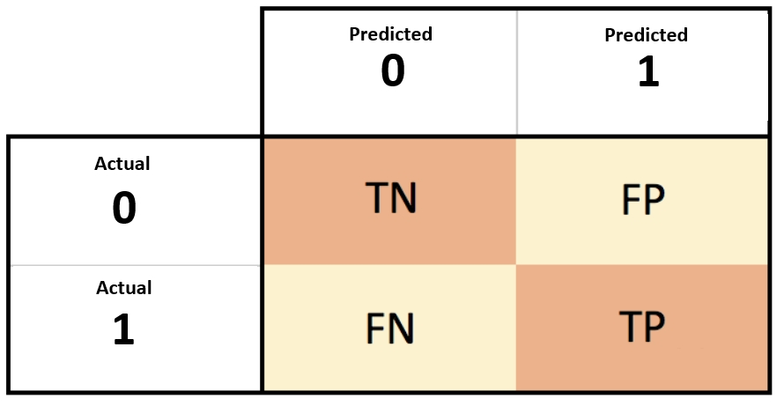
Example of a Confusion Matrix
Suppose we fit a decision tree to predict if a consumer buys a coke
target: ‘1’ for buy a coke; ‘0’ for did not buy a coke.
predicted not to buy coke, and actually did not buy coke
True Negative
False Positive
20 observations
30 observations
False Negative
True Positive
10 observations
40 observations
predicted not to buy coke, but actually buys coke
Predicted to buy coke, and actually buys coke

Slide 67
3 Scores from Confusion Matrix
Accuracy Score = TN + TP / (TN + FP + TP + FN) = (20 + 40)/100 = 0.60
Proportion of observations correctly classified in the sample
Precision Score = TP / (TP + FP) = 40 / (30 + 40) = 4/7 = 0.57
Proportion of observations correctly classified in the subsample which is predicted to buy coke
Recall Score = TP / (TP + FN) = 40 / (40 + 10) = 4/5 = 0.80
Proportion of observations correctly predicted to buy coke in the subsample that actually bought coke

Slide 68
Plot Decision Trees (I)
Decision tree plot is an important tool to understand and to evaluate its performance.
The plot can be generated by the plot_tree() function of the tree module conveniently.
The plot_tree() function can also be combined with the matplotlib options to optimise the output of the tree.
tree.plot_tree(decision_tree, max_depth = None, feature_names = None, class_names = None, label = "all", filled = False, impurity = True, node_ids = False, proportion = False, rounded = False, precision = 3, ax = None, fontsize = None)
Notes:
The most important tool to understand and to evaluate a decision tree is the plot of the tree itself.
The tree module of the scikit-learn package provides the plot_tree() function to generate such a graph conveniently.
The plot_tree() function can also be combined with the matplotlib options such as the plot size, the borderline settings, etc. to optimise the output of the tree.

Slide 69
Plot Decision Trees (II)
Here is a list of the parameters of the plot_tree() function.
(Source: https://scikit-learn.org/stable/modules/generated/sklearn.tree.plot_tree.html)
Parameter | Value Type
decision_tree (No default value) | Decision tree object
max_depth (Default: None) | Integer
feature_names (Default: None) | List of strings
class_names (Default: None) | List of strings or Boolean
label (Default: "all") | "all", "root", "none"
filled (Default: False) | Boolean
impurity (Default: True) | Boolean
Notes:
Here is a list of the parameters of the plot_tree() function.
decision_tree is the estimated decision tree object to be plotted.
max_depth is the maximum depth of the representation. If None, the tree is fully generated.
feature_names is the names of each of the features (variables). If None, generic names will be used ("X[0]", "X[1]", …).
class_names is the names of each of the target classes in ascending numerical order. Only relevant for classification and not supported for multi-output. If True, the graph shows a symbolic representation of the class name.
label controls whether to show informative labels for impurity, etc. or not. Options include "all" to show at every node, "root" to show only at the top root node, or "none" to not show at any node.
filled controls whether to paint the nodes to indicate majority class for classification or extremity of values for regression or not.
Impurity controls whether to show the impurity at each node or not.

Slide 70
Plot Decision Trees (III)
(Source: https://scikit-learn.org/stable/modules/generated/sklearn.tree.plot_tree.html)
Parameter | Value Type
node_ids (Default: False) | Boolean
proportion (Default: False) | Boolean
rounded (Default: False) | Boolean
precision (Default: 3) | Integer
ax (Default: None) | matplotlib axes
fontsize (Default: None) | Integer
Notes:
node_ids controls whether to show the ID number on each node or not.
proportion controls whether to change the display of ”values” and/or “samples” to be proportions and percentages, respectively, or not.
rounded controls whether to draw node boxes with rounded corners and use Helvetica fonts instead of Times-Roman or not.
precision is the number of digits of precision for floating point in the values of impurity, threshold and value attributes of each node.
ax is axes to plot to. If None, use current axis. Any previous content is cleared.
fontsize is the size of text font. If None, determined automatically to fit figure.

Slide 71
Activity
Run through the SU5 Decision Tree Notebook

Slide 72
Discussion
Name all the main differences between classification trees and regression trees.
How do we judge a model with low prediction accuracy for testing data but high accuracy for training data? Is it possible for a model to have low prediction accuracy for training data, but high accuracy for training data?

Slide 73
Discussion (answers)
Name all the main differences between classification trees and regression trees.
Classification: binary / categorical target; regression: continuous target
Classification: confusion matrix; regression: gini entropy
How do we judge a model with low prediction accuracy for testing data but high accuracy for training data?
Overfit model; model learnt relationships specific to training data
Is it possible for a model to have low prediction accuracy for training data, but high accuracy for testing data?
Usually no; if it happens, your dataset might be too small
https://www.ibm.com/cloud/learn/underfitting

Slide 74
Activity
Car sales program:
Carry out the following tasks in JupyterLab using the prepared DataFrame from the first chapter:
Predict the selling price of the cars using decision tree.
Evaluate the prediction of the decision tree by confusion matrix.
Plot the estimated decision tree solution using the plot_tree() function.

Slide 75
Discussion
Name all the main differences between classification trees and regression trees.
Classification: binary / categorical target; regression: continuous target

